Slide 1
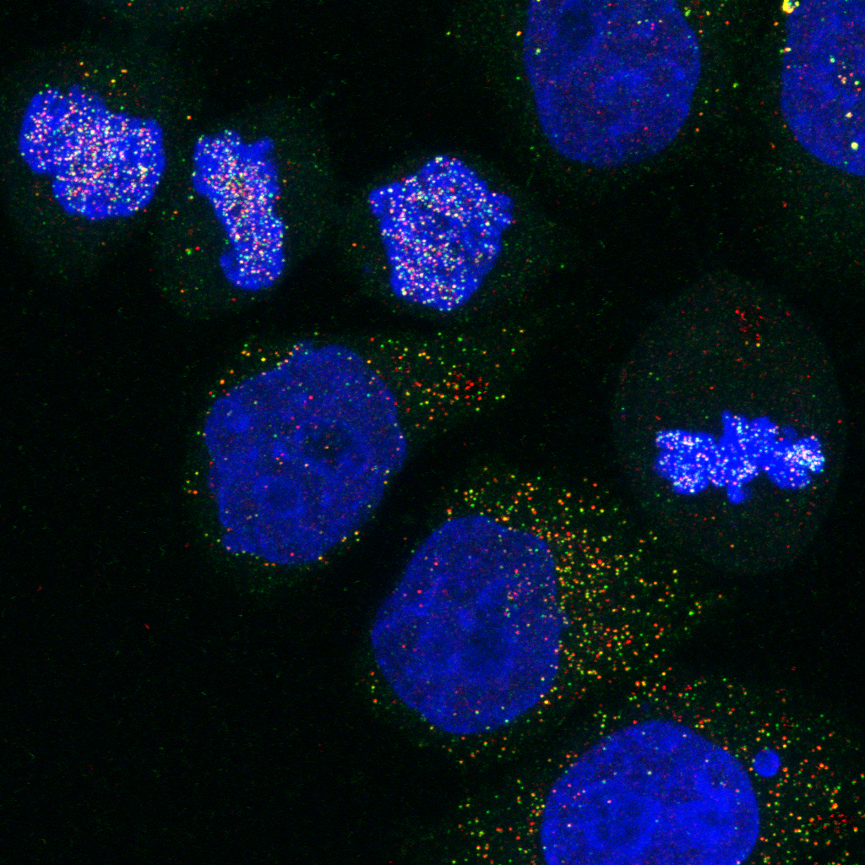
Co-occurance Based approaches

Slide 2
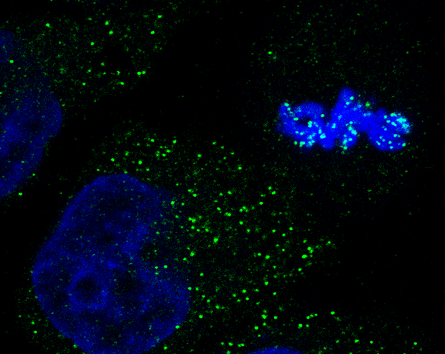
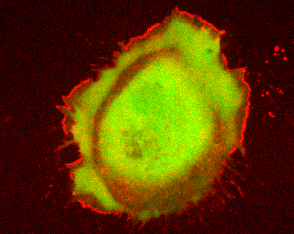
Object-Based colocalisation
Detect objects in different channels and relate positions
Is signal nuclear or non-nuclear
Plot distributions from cell boundary

Slide 3
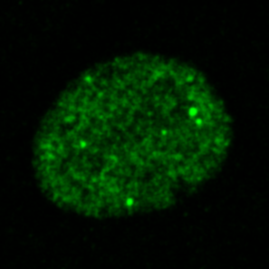
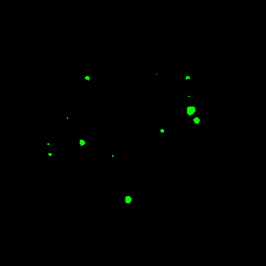
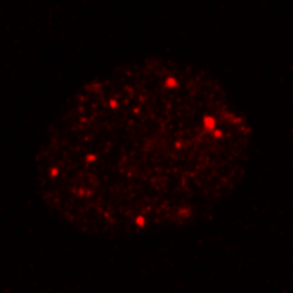
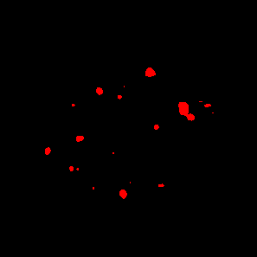
Object-based correlation coefficients
Detect objects:
Thresholding
Local maxima detection
Relate objects:
% Overlap
But with high resolution, probes may not overlap!
Nearest Neighbour
Mean Distance to Other objects
Cluster analysis

Slide 4
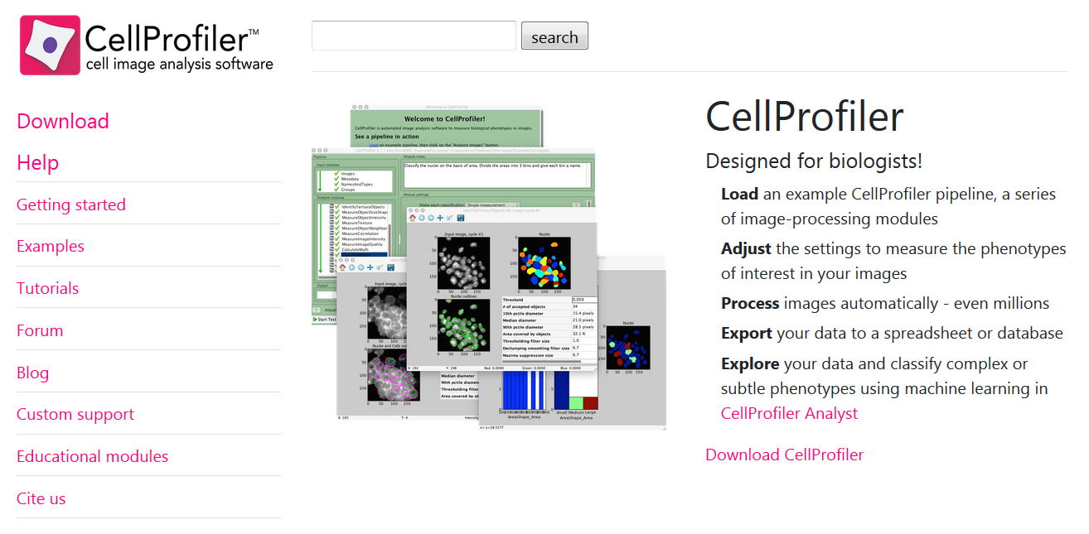
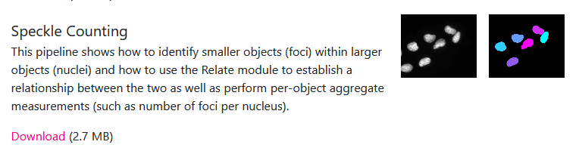
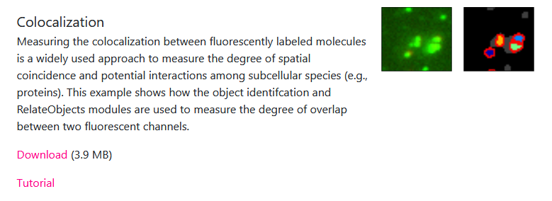

Slide 5
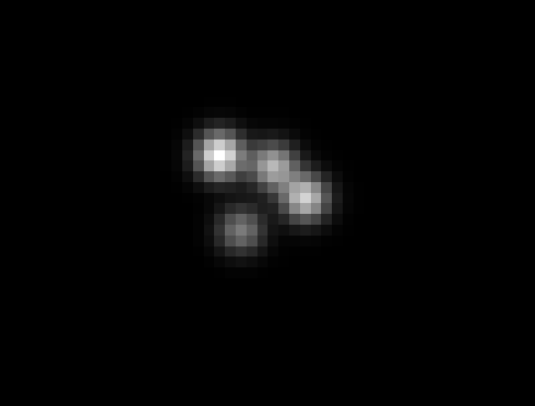
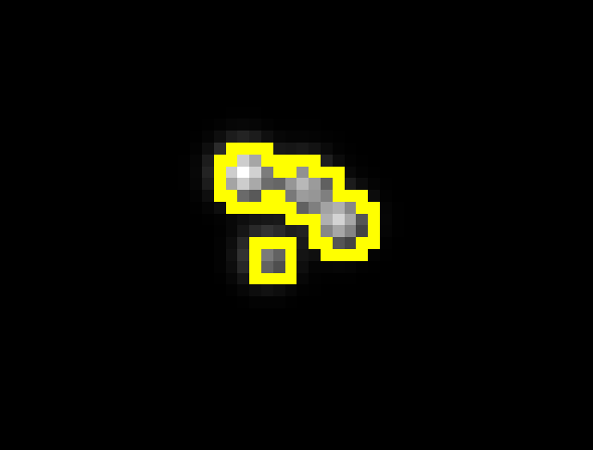
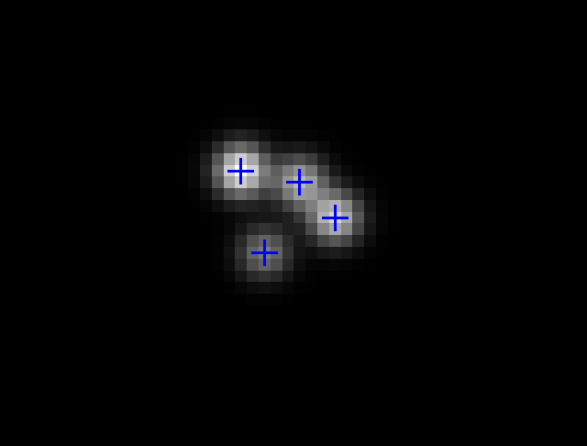
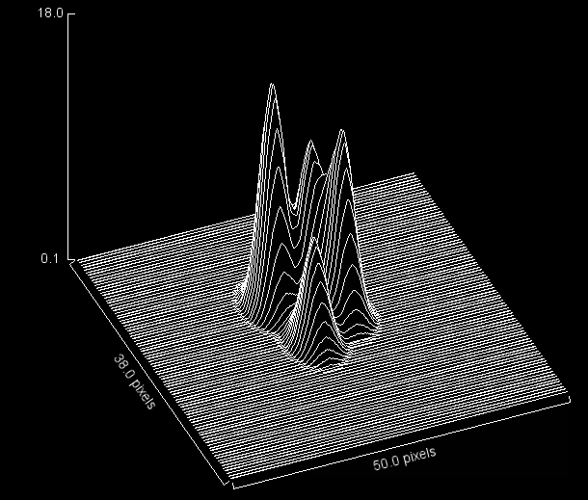
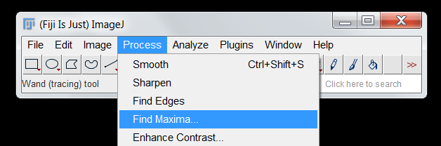

Slide 6
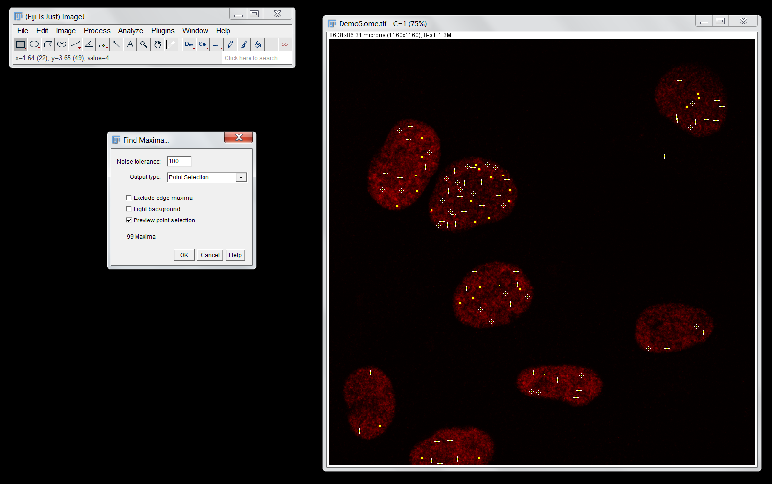

Slide 7
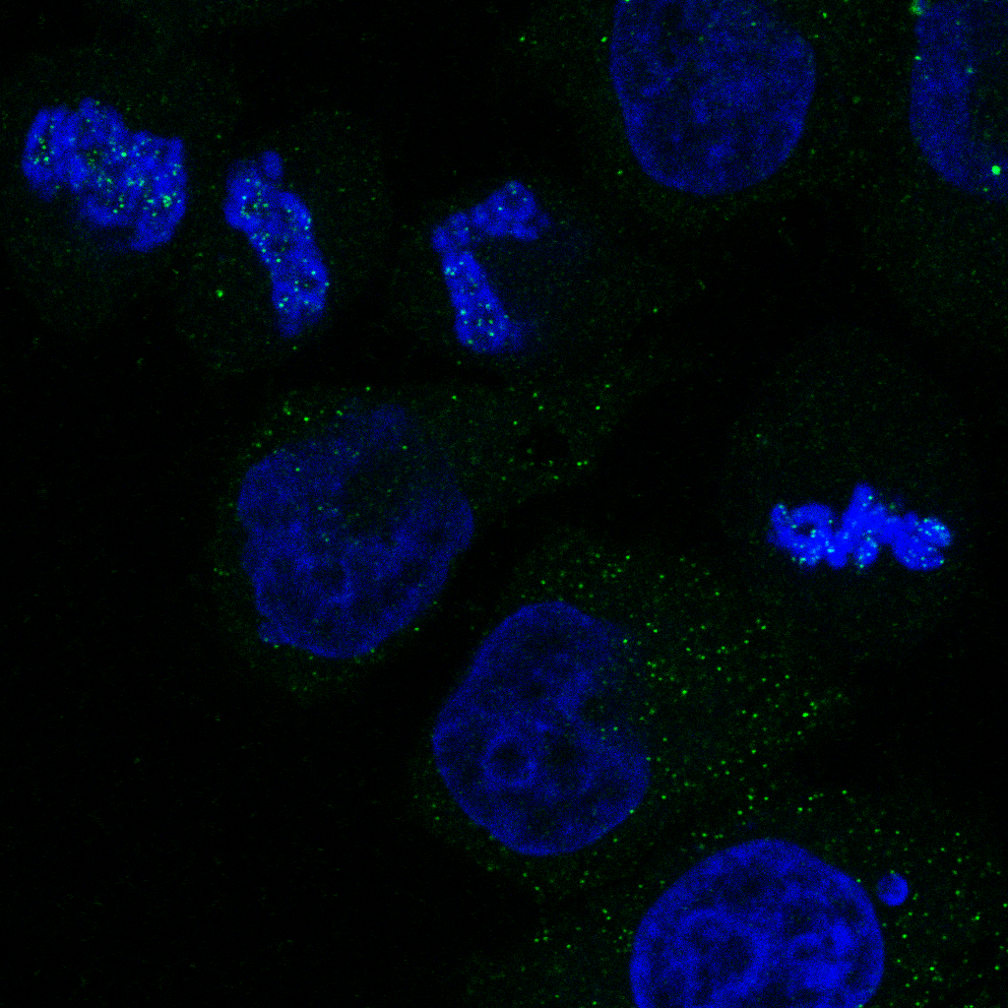
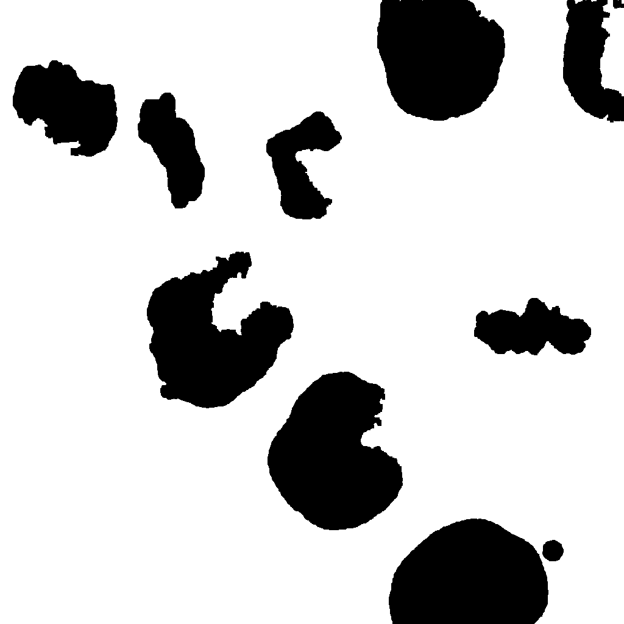
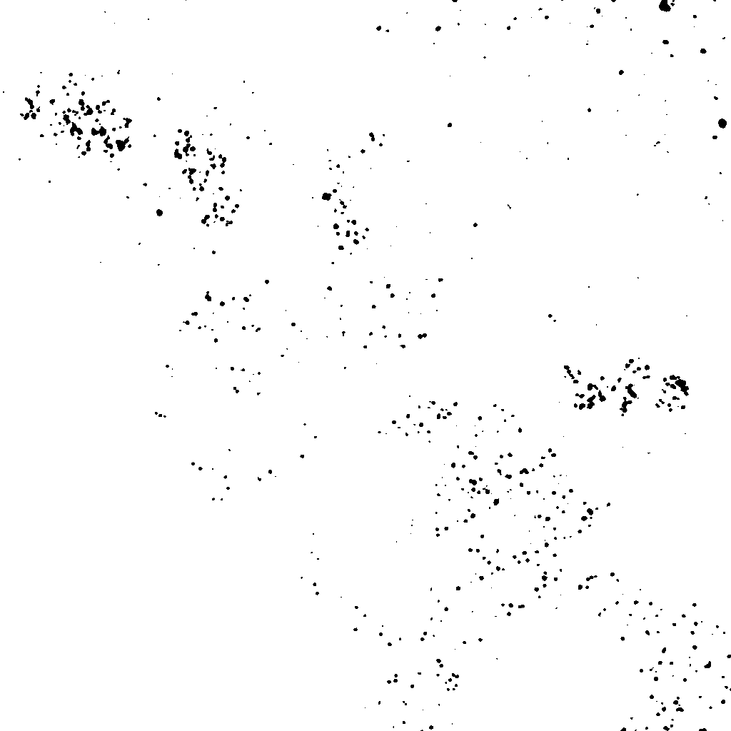
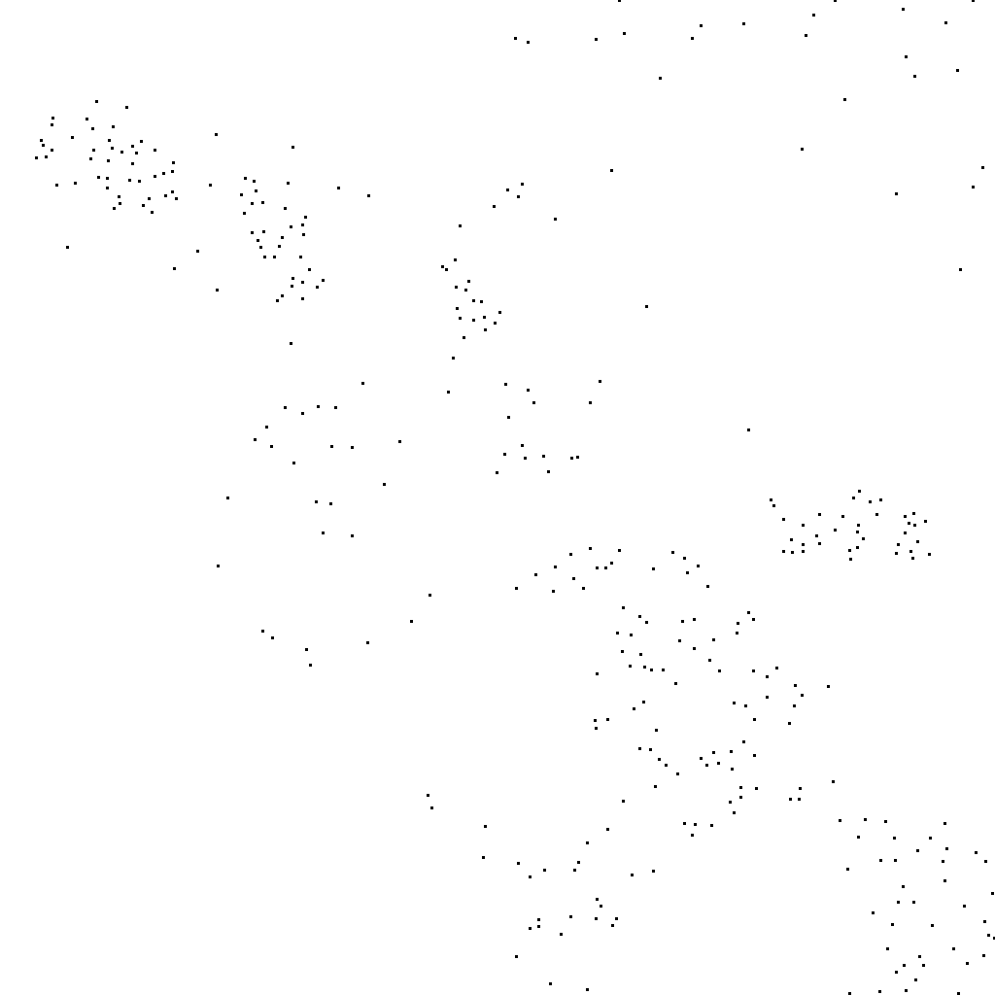
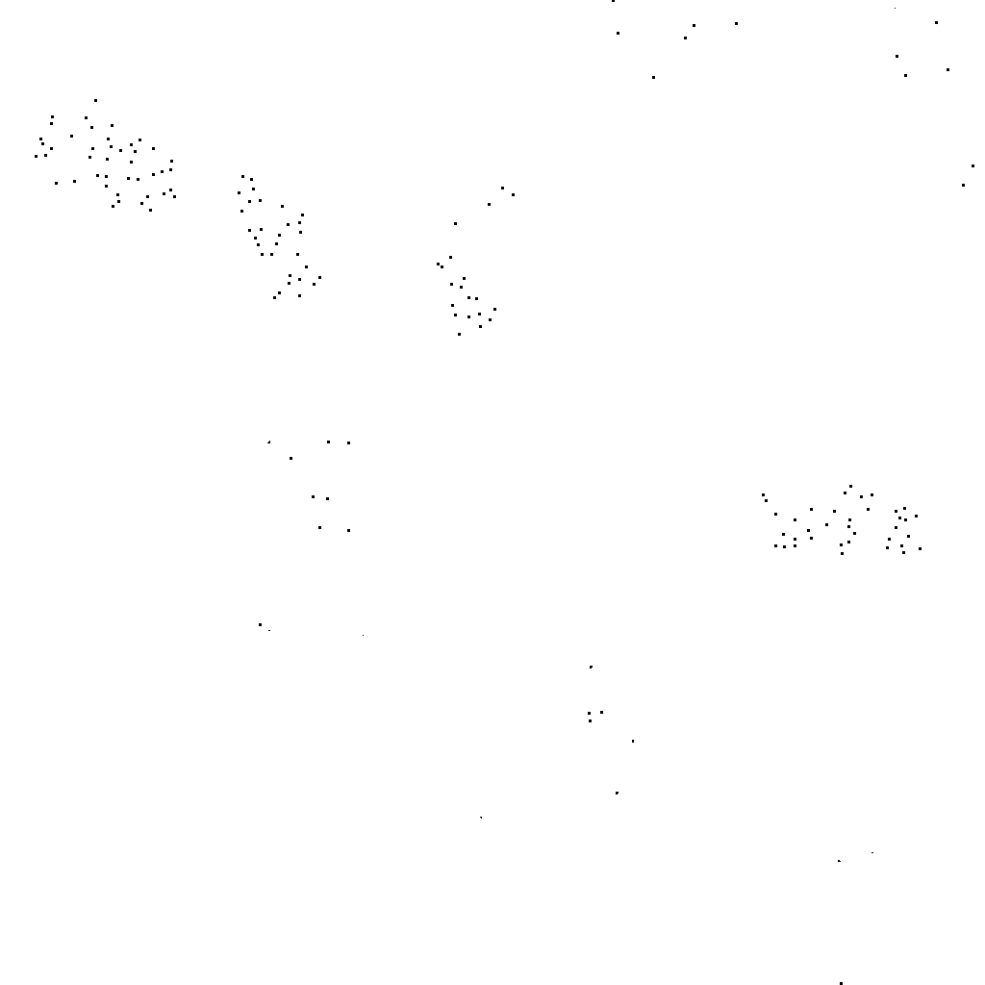
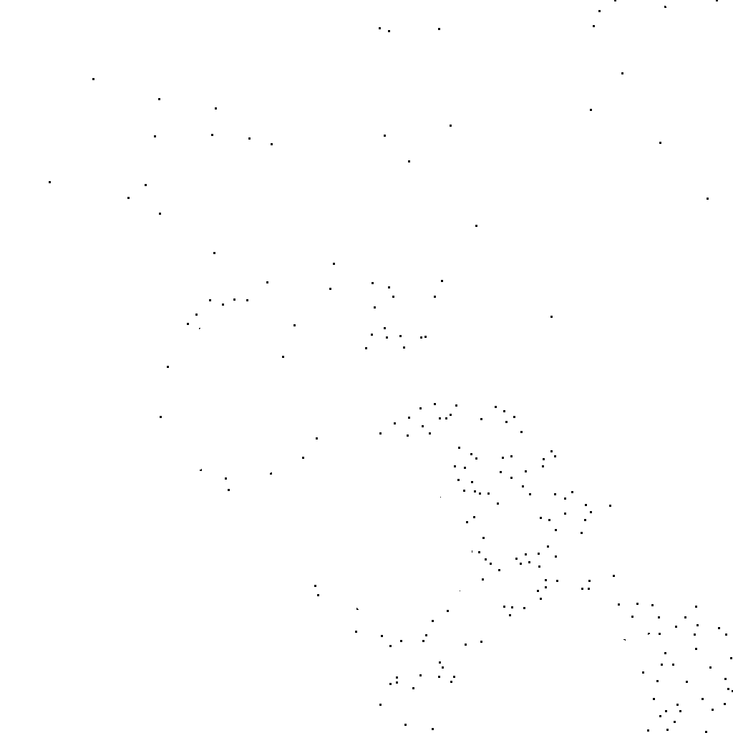
Relating different objects
Thresholded Dots
Find Maxima Dots
Nuclear Dots
Non-Nuclear Dots

Slide 8
Demo 6: Simple differentiation based on regions

Slide 9

A more refined approach relates distances…
Euclidean geometry – computationally intensive:
(x₁, y₁)
d
(x₂, y₂)
$$d= \sqrt{{\left(x_{2}−x_{1}\right)}^{2}+{(y_{2}−y_{1})}^{2}}$$
Counting pixels – limited resolution, but fast:
(x₁, y₁)
1
2
3
(x₂, y₂)

Slide 10
Distance Maps
1 | 1 | 1 | 1 | 1 | 1 | 1 | 1 | 1 | 1
1 | 0 | 1 | 0 | 0 | 1 | 1 | 1 | 0 | 1
1 | 1 | 0 | 0 | 0 | 1 | 0 | 0 | 0 | 1
1 | 0 | 0 | 0 | 0 | 0 | 0 | 0 | 0 | 1
1 | 0 | 0 | 0 | 0 | 0 | 0 | 0 | 0 | 1
1 | 1 | 0 | 0 | 0 | 0 | 0 | 0 | 1 | 1
1 | 0 | 0 | 0 | 0 | 0 | 0 | 0 | 1 | 1
1 | 0 | 0 | 0 | 0 | 0 | 0 | 0 | 1 | 1
1 | 0 | 1 | 1 | 1 | 0 | 0 | 0 | 1 | 1
1 | 1 | 1 | 1 | 1 | 1 | 1 | 1 | 1 | 1
0 | 0 | 0 | 0 | 0 | 0 | 0 | 0 | 0 | 0
0 | 1 | 0 | 1 | 1 | 0 | 0 | 0 | 1 | 0
0 | 0 | 1 | 1 | 1 | 0 | 1 | 1 | 1 | 0
0 | 1 | 1 | 2 | 1 | 1 | 1 | 2 | 1 | 0
0 | 1 | 1 | 2 | 2 | 2 | 2 | 1 | 1 | 0
0 | 0 | 1 | 2 | 3 | 3 | 2 | 1 | 0 | 0
0 | 1 | 1 | 2 | 2 | 2 | 2 | 1 | 0 | 0
0 | 1 | 1 | 1 | 1 | 1 | 2 | 1 | 0 | 0
0 | 1 | 0 | 0 | 0 | 1 | 1 | 1 | 0 | 0
0 | 0 | 0 | 0 | 0 | 0 | 0 | 0 | 0 | 0

Slide 11

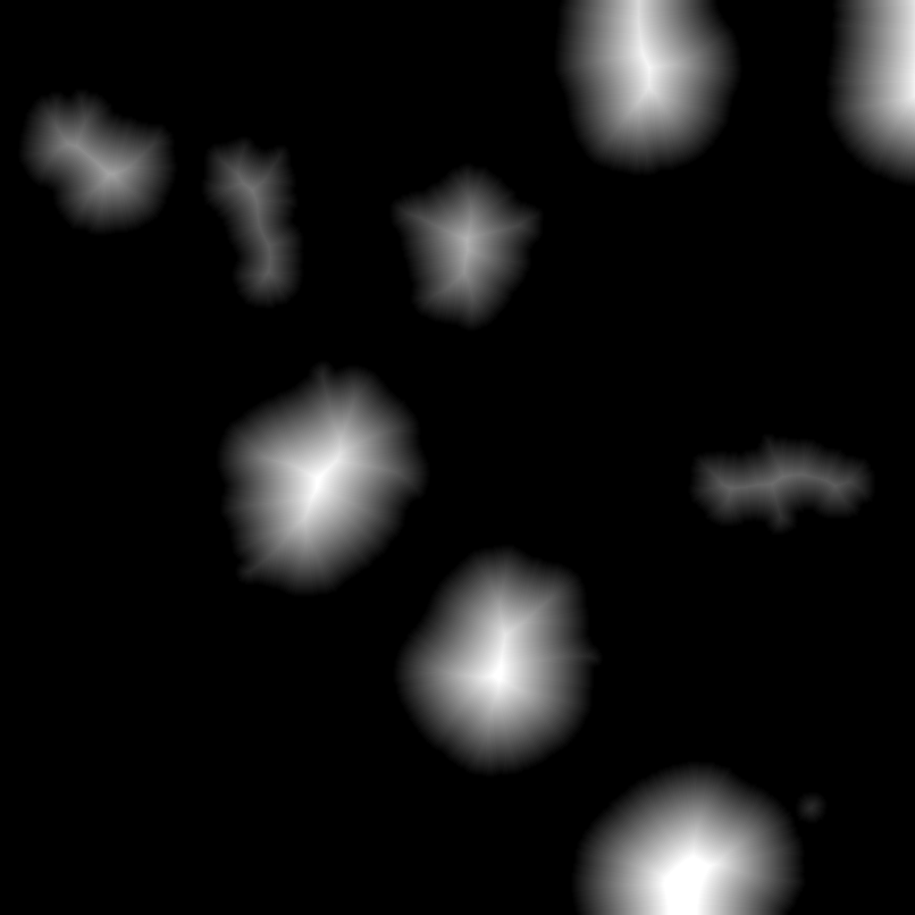
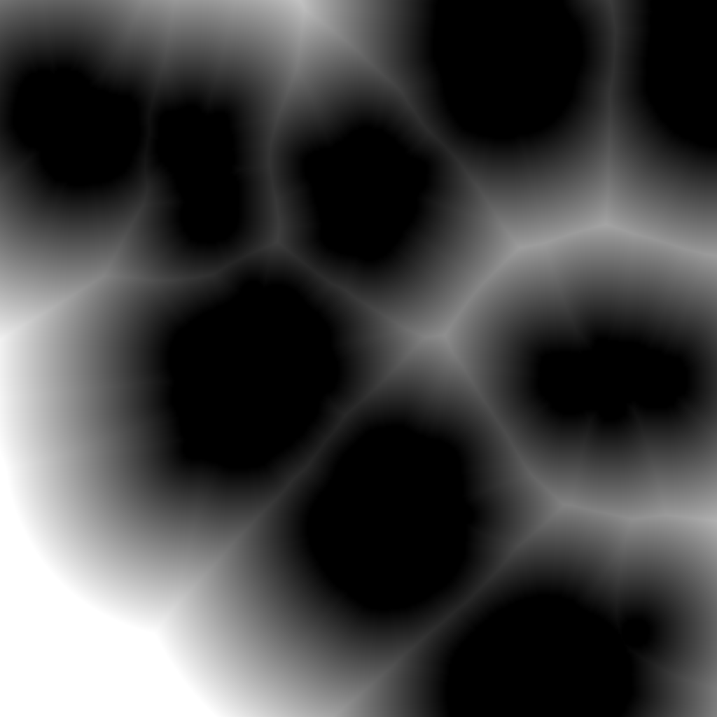

Slide 12
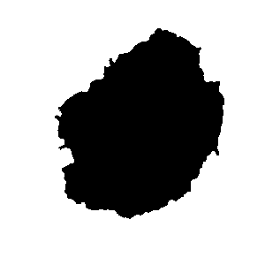
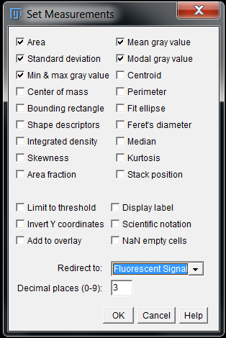
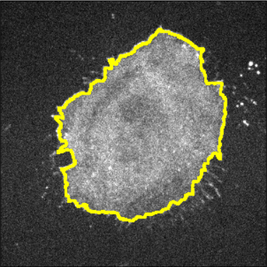
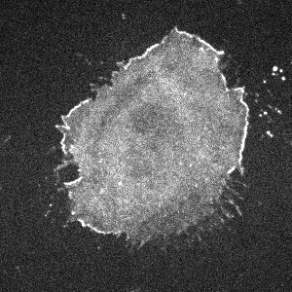
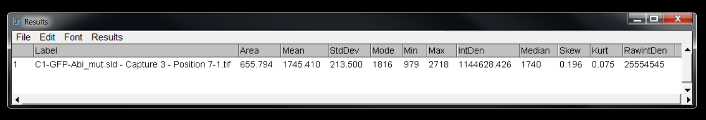
Binary Mask
FIJI will always apply measurements to whatever image is specified here
Fluorescent Signal

Slide 13
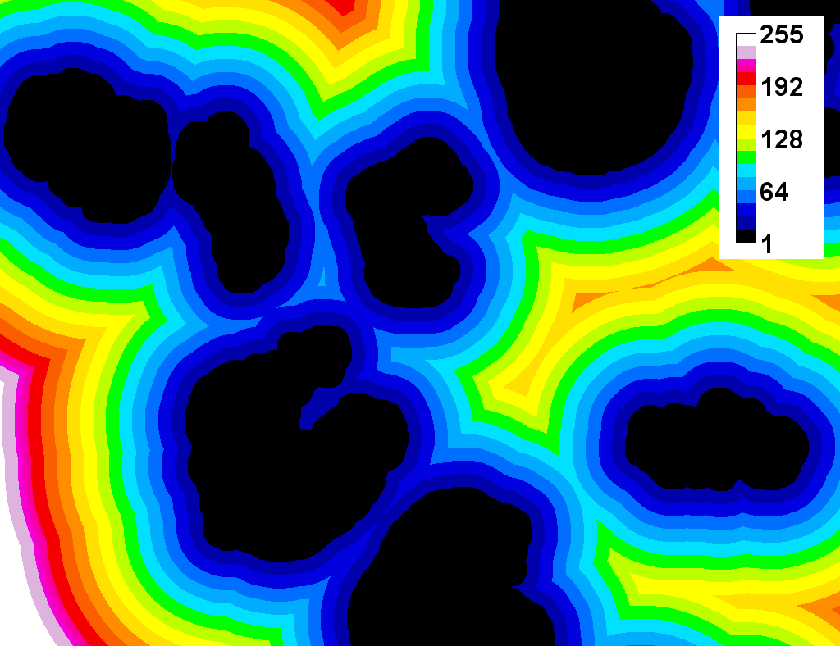
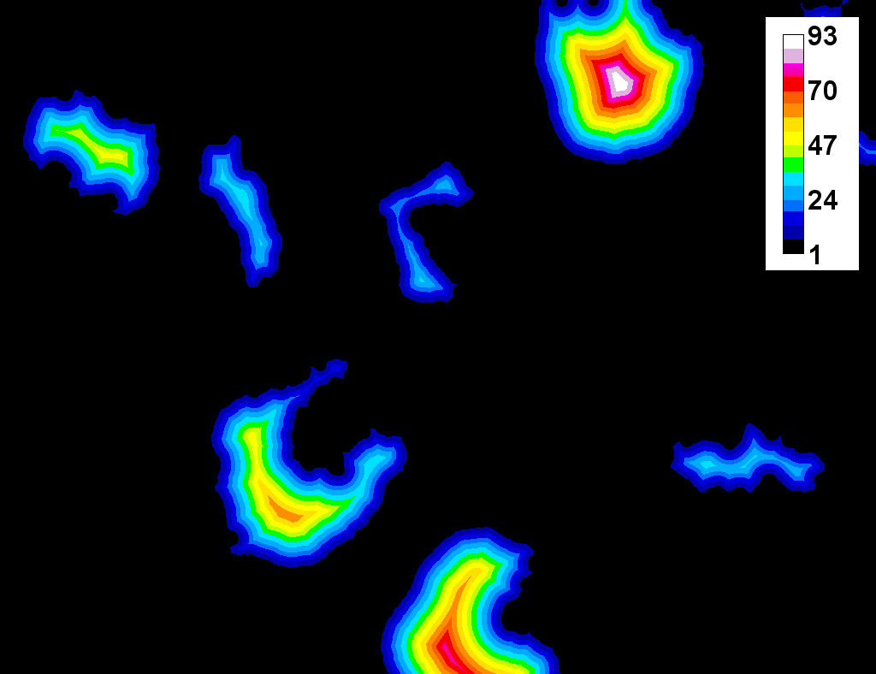
Using maps to plot distances

Slide 14
Demo 7: Calculate relative nuclear expression

Slide 15
Challenge 1: nuclear localisation
Open the images in the Challenge 1 folder with Bio-Formats:
Measure the mean distance of dots in channel 1 to the nuclei in channel 2
Generate a distance map based on the nuclear channel
Detect the dots in channel 1
Use the Particle Analyzer to measure the distance of each dot from the nuclei

Slide 16
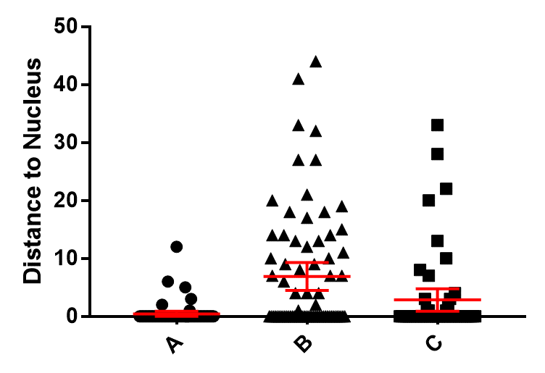

Slide 17
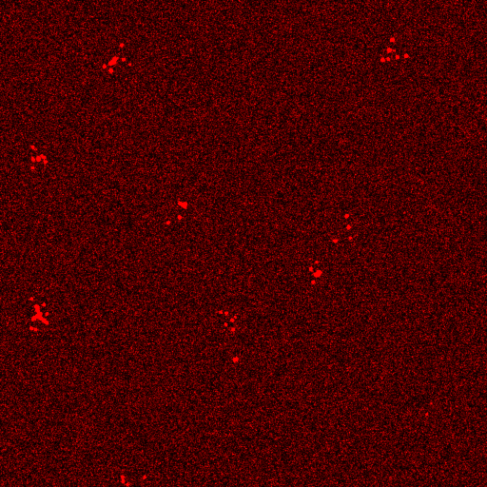
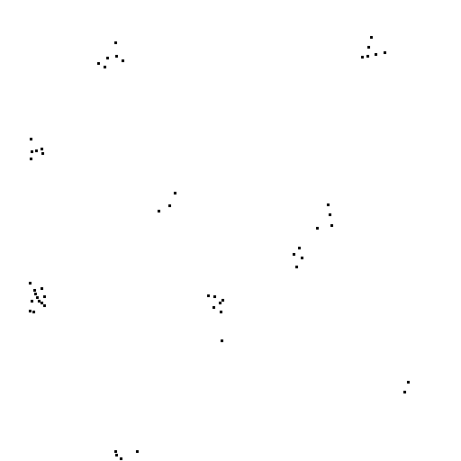
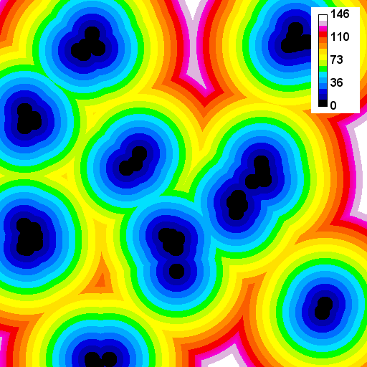
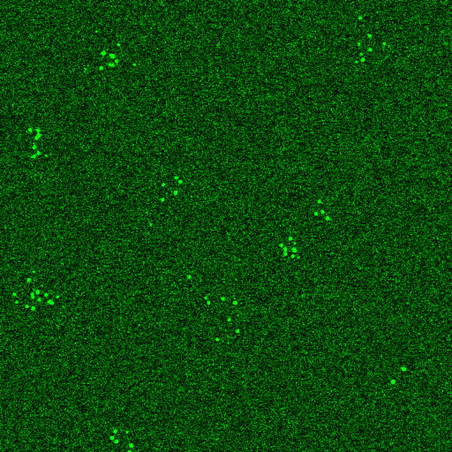
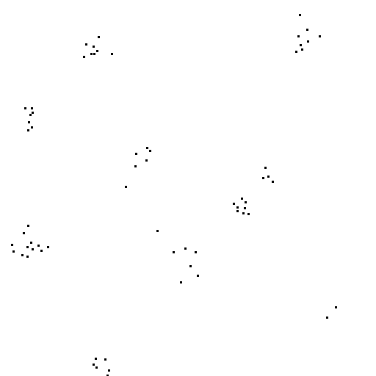
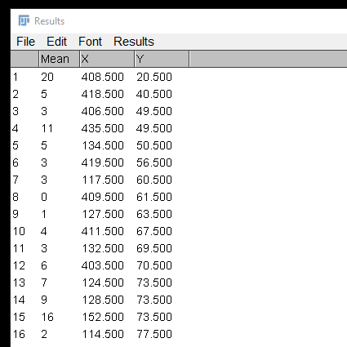

Slide 18
Demo 8: distance maps to measure localisation

Slide 19
Challenge 2: colocalization of dots
Open the images in the Challenge 2 folder with Bio-Formats:
Measure the mean distance of dots in channel 1 to the dots in channel 2
Generate a distance map based on the dots in channel 1
Detect the dots in channel 2
Use the Particle Analyzer to measure the distance of each dot in one channel from the other

Slide 20
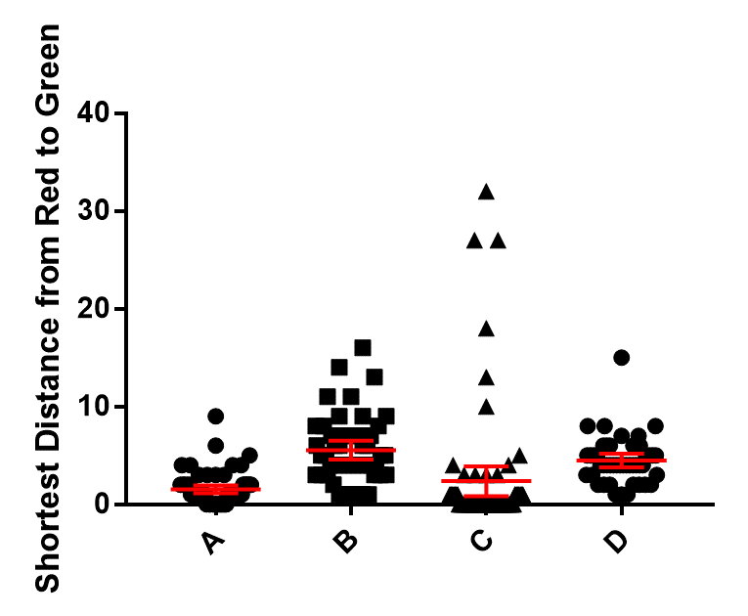

Slide 21
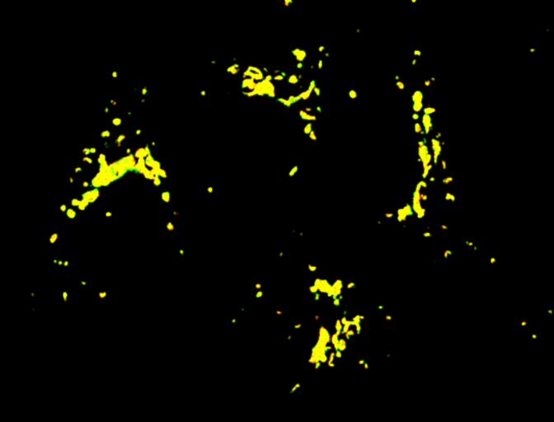
“Colocalisation” means different things to different people
Red + Green = Yellow?
Co-occurrence:
Molecules present in a region
No concentration relationship
Correlation analysis:
Stoichiometric relationship between molecules
No spatial information
A
B

Slide 22



Crick Advanced Light Microscopy ● SW302 ● david.barry@crick.ac.uk

Slide 23
Useful References
https://dx.doi.org/10.1083/jcb.200903097
https://dx.doi.org/10.1073/pnas.1711314115
https://dx.doi.org/10.1152/ajpcell.00462.2010
https://doi.org/10.1111/j.1365-2818.2006.01706.x
https://doi.org/10.1529/biophysj.103.038422
https://doi.org/10.1242/jcs.211847
https://doi.org/10.1371/journal.pone.0111983
https://doi.org/10.1038/nmeth.3587

